Slide 1
Hate Speech Detection
Alexandru Gavrila
Andrei Munteanu

Slide 2
What is Hate Speech?
Offensive/hateful
Targeted group (religion, race, sex, etc.)
Not to be confused with obscene, toxic, foul

Slide 3
Is this field researched?
~37.000 results on Google Scholar
Different approaches and benchmarks for ML

Slide 4
Where to find Hate Speech?
Social Media
Other online platforms
Extremist communities (outside the scope of the project)

Slide 5
Why detect Hate Speech?
To censor it
To prevent spread of hateful ideas

Slide 6
How to detect Hate Speech?
Keyword search (not effective)
Use NLP and ML (better)

Slide 7
State of the Art
Bert(Bidirectional Encoder Representations from Transformers) + HateXplain
BiLSTM + Attention(importance of words)

Slide 8
Datasets
Most common datasets are tweets
Labels are usually: hateful, offensive, neutral
Manual annotation
2 Datasets

Slide 9
How is NLP useful?
Keyword searches are weak
Hate speech using common words – hard to detect

Slide 10
Embeddings
Word2Vec
Glove6B100
HashingVectorizer

Slide 11
Preprocessing
Tokenizer
Padding
Stop words
Punctuation

Slide 12
Metrics
Accuracy
Loss
AUC

Slide 13
Models
Deep Learning
Normal Multi-Layer Perceptron
Logistic Regression

Slide 14
Deep Learning
Convnets
LSTM
BiLSTM

Slide 15
MLP
1 hidden layer
128 neurons
Binary cross entropy
Adam

Slide 16
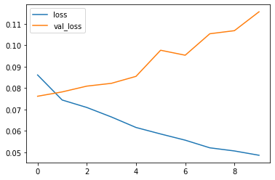
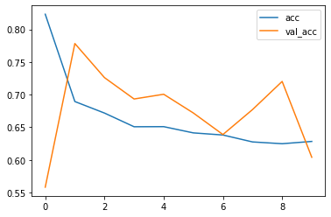
MLP
Accuracy on dataset 1: 0.96
Accuracy on dataset 2: 0.77
AUC: 0.96

Slide 17
Convnet
3 hidden Conv1D (128 neurons, 3 kernel size)
MaxPooling
1 hidden fully connected(128 neurons)
Binary cross entropy
RMSprop

Slide 18
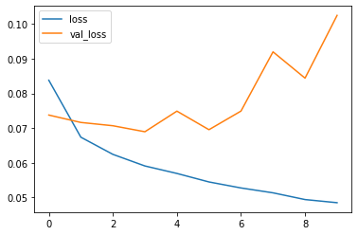
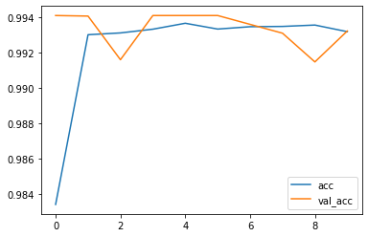
Convnet
Accuracy on dataset 1: 0.9941
Accuracy on dataset 2: 0.7924
AUC: 0.975

Slide 19
LSTM
1 LSTM layer with 15 cells
GlobalMaxPooling
Binary cross entropy
Adam

Slide 20
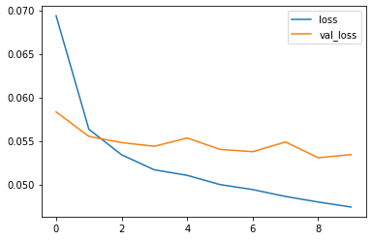
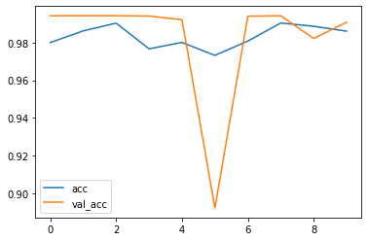
LSTM
Accuracy on dataset 1: 0.9941
Accuracy on dataset 2: 0.7924
AUC: 0.980

Slide 21
BiLSTM
1 LSTM layer with 15 cells
GlobalMaxPooling
Binary cross entropy
Adam

Slide 22
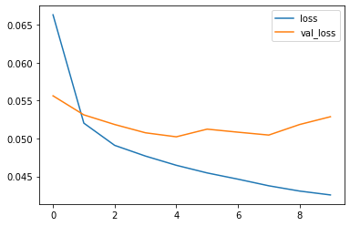
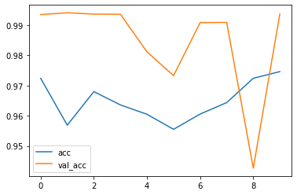
BiLSTM
Accuracy on dataset 1: 0.9941
Accuracy on dataset 2: 0.7924
AUC: 0.985

Slide 23
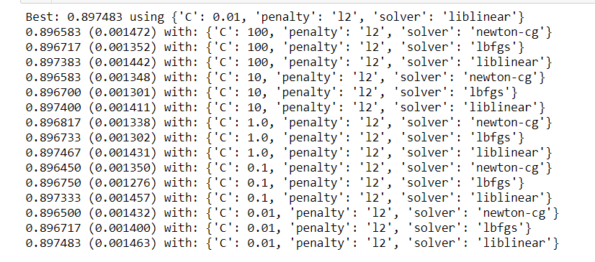
Logistic Regression
Grid Search

Slide 24
Logistic Regression
Accuracy on dataset 1: 0.89
Accuracy on dataset 2: 0.54

Slide 25
Conclusions
Deep Learning seems better than standard MLP
Word2Vec better than Hashing Vectorizer
Best results: combination of NLP and DL

Slide 26
References
HateXplain: A Benchmark Dataset for Explainable Hate Speech Detection
Automated Hate Speech Detection and the Problem of Offensive Language
On the Role of Text Preprocessing in Neural Network Architectures: An Evaluation Study on Text Categorization and Sentiment Analysis

